Slide 1
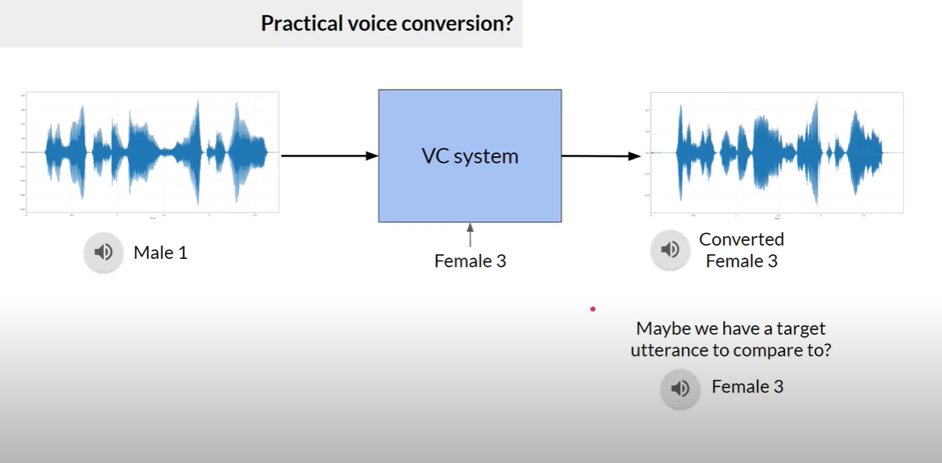
What is Voice conversion?

Slide 2
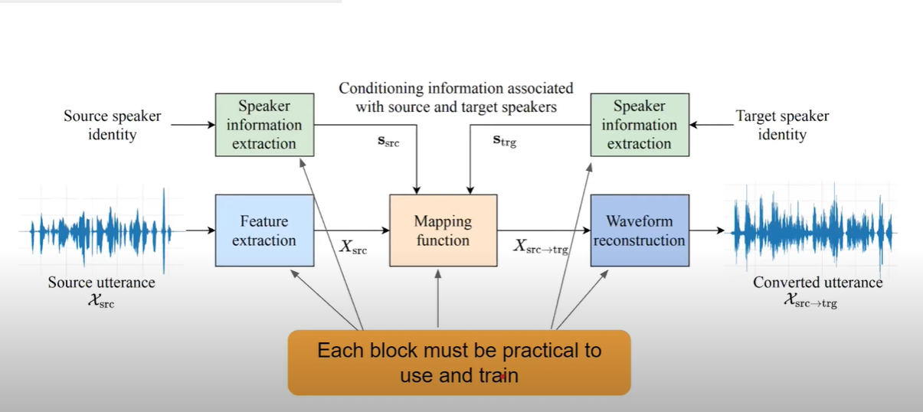
Component of a VC system

Slide 3
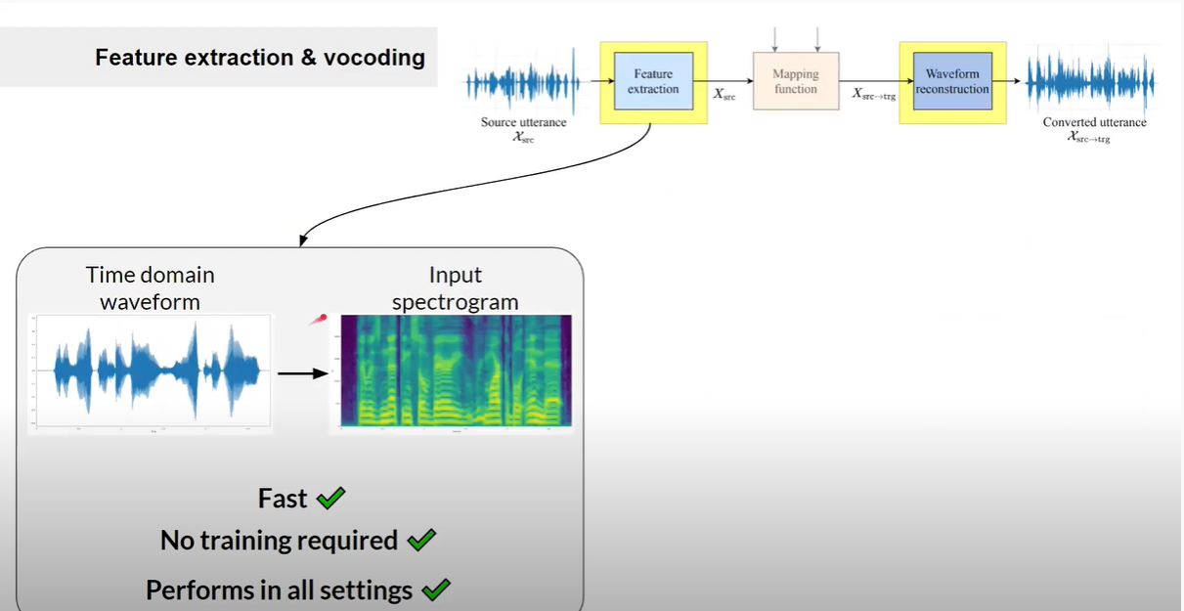

Slide 4
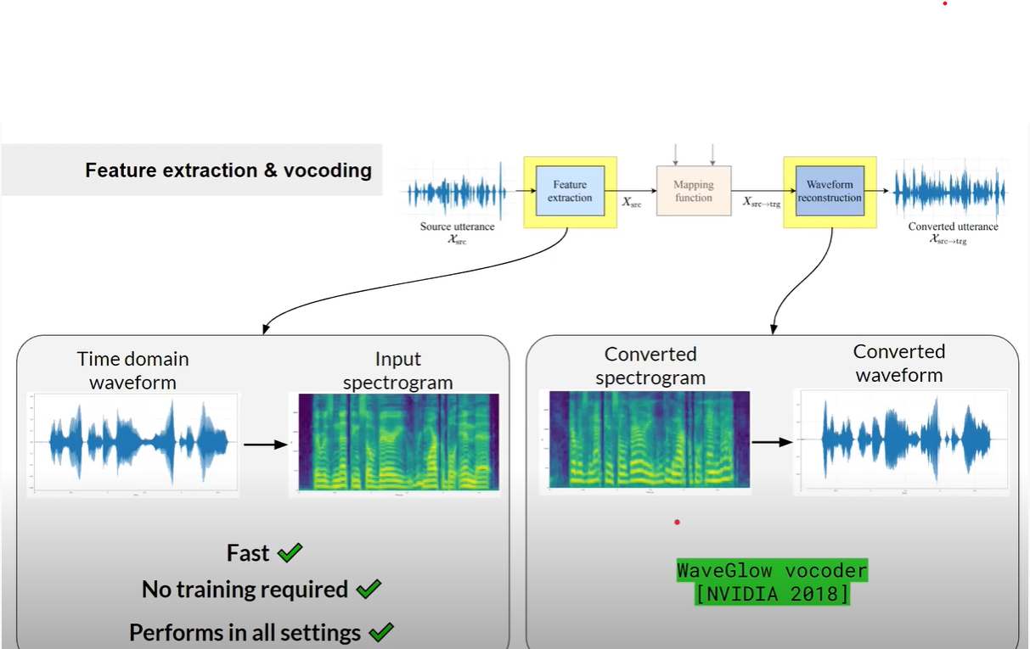

Slide 5
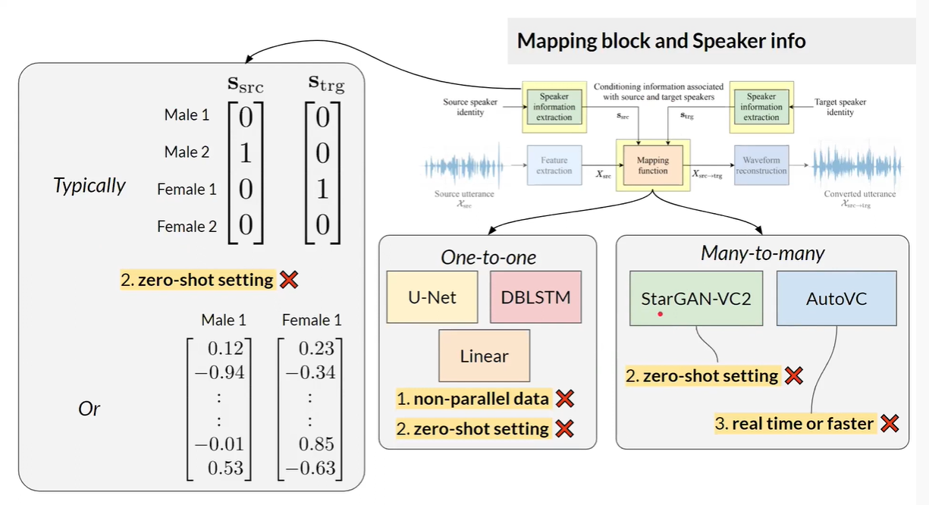

Slide 6
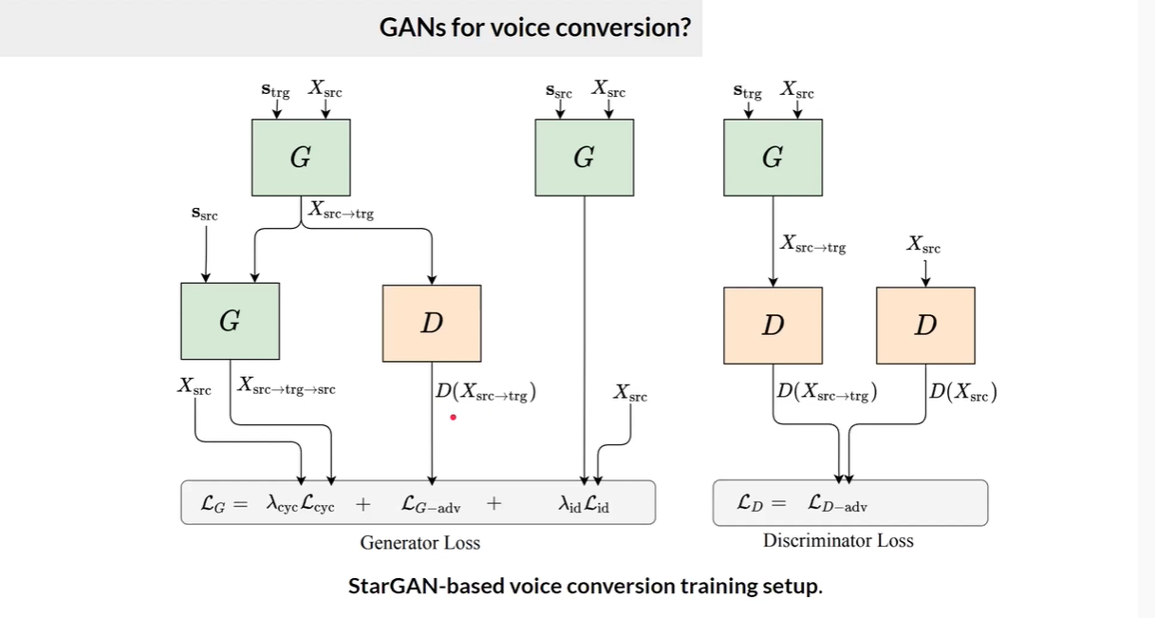

Slide 7
Objectives of the Generator
The Generator weights are adjusted so that the voices generated are realistic.
The Generator weights are adjusted so that the generated voice are classifiable as target domain.

Slide 8
Objectives of the Discriminator
It should be able to identify whether a voice is fake or not.
Discriminator can also predict the domain of the voice given as input or not.

Slide 9
Setting up the Environment
*Don’t use windows/Google Colab as Tensorflow version is not compatible with it.
Used Ubuntu 20.0 version of OS
Tensorflow ==1.8
Librosa
Soundfile
Pyworld
Tensorboard
Sckit-learn
Numpy==1.16.2

Slide 10
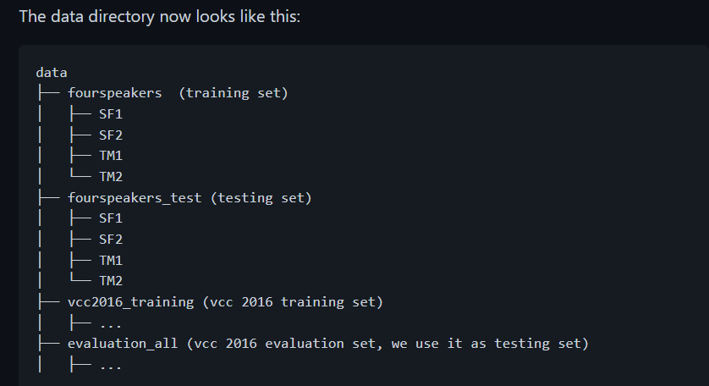
Downloading the dataset

Slide 11
Fix in the code of download.py
REPLACE this below code –
from multiprocessing SimpleQueue import SimpleQueue as Queue
from queue import SimpleQueue as Queue
WITH
from multiprocessing import SimpleQueue as Queue

Slide 12
Preprocessing data
Extract features (mcep, f0, ap) from each speech clip. The features are stored as .npy files. We also calculate the statistical characteristics for each speaker.
Test set does not need preprocessing.

Slide 13
Training
Read .npy files from the processed_dir to train model and raw wav files from test_wav_dir to randomly generate some samples using the model during training.
Add this line
import soundfile as sf #new line added
And Replace below line
#librosa.output.write_wav(f'{wavpath}/{wavname}', synwav, sr=fs)
WITH
sf.write(f'{wavpath}/{wavname}', synwav, samplerate=fs) #new line added

Slide 14
Save the model
Restore model from model_dir, convert source_speaker’s speech to target_speaker’s speech. The results are stored in ./converted_voices .
Command - python convert.py --model_dir ./your_model_dir -- source_speaker SF1 --target_speaker TM1

Slide 15
SUBJECTIVE EVALUATION
To confirm the performance of the proposed method, we conducted subjective evaluation experiments on a non-parallel many-to-many speaker identity conversion task. We used the Voice Conversion Challenge (VCC) 2018 dataset [50], which consists of recordings of six female and six male US English speakers. We used a subset of speakers for training and evaluation. Specifically, we selected two female speakers, ‘VCC2SF1’ and ‘VCC2SF2’, and two male speakers, ‘VCC2SM1’ and ‘VCC2SM2’. Thus, c is represented as a four-dimension alone-hot vector and there were twelve different combinations of source and target speakers in total.

Slide 16
CONCLUSION
This paper proposed a method that allows non-parallel many to many VC by using a novel GAN variant called StarGAN. Our method, which we call StarGAN-VC, is noteworthy in that it
(1) requires no parallel utterances, transcriptions, or time alignment procedures for speech generator training,
(2) simultaneously learn many-to-many mappings across different voice attribute domains using a single generator network,
(3)is able to generate signals of converted speech quickly enough to allow real-time implementations and
(4)requires only several minutes of training examples to generate reasonably realistic sounding speech subjective evaluation experiments on and on-parallel many-to-many speaker identity conversion task revealed that the proposed method obtained higher sound quality and speaker similarity than a base line.

